Slide 1
Model optimization
Machine Learning with Python

Slide 2
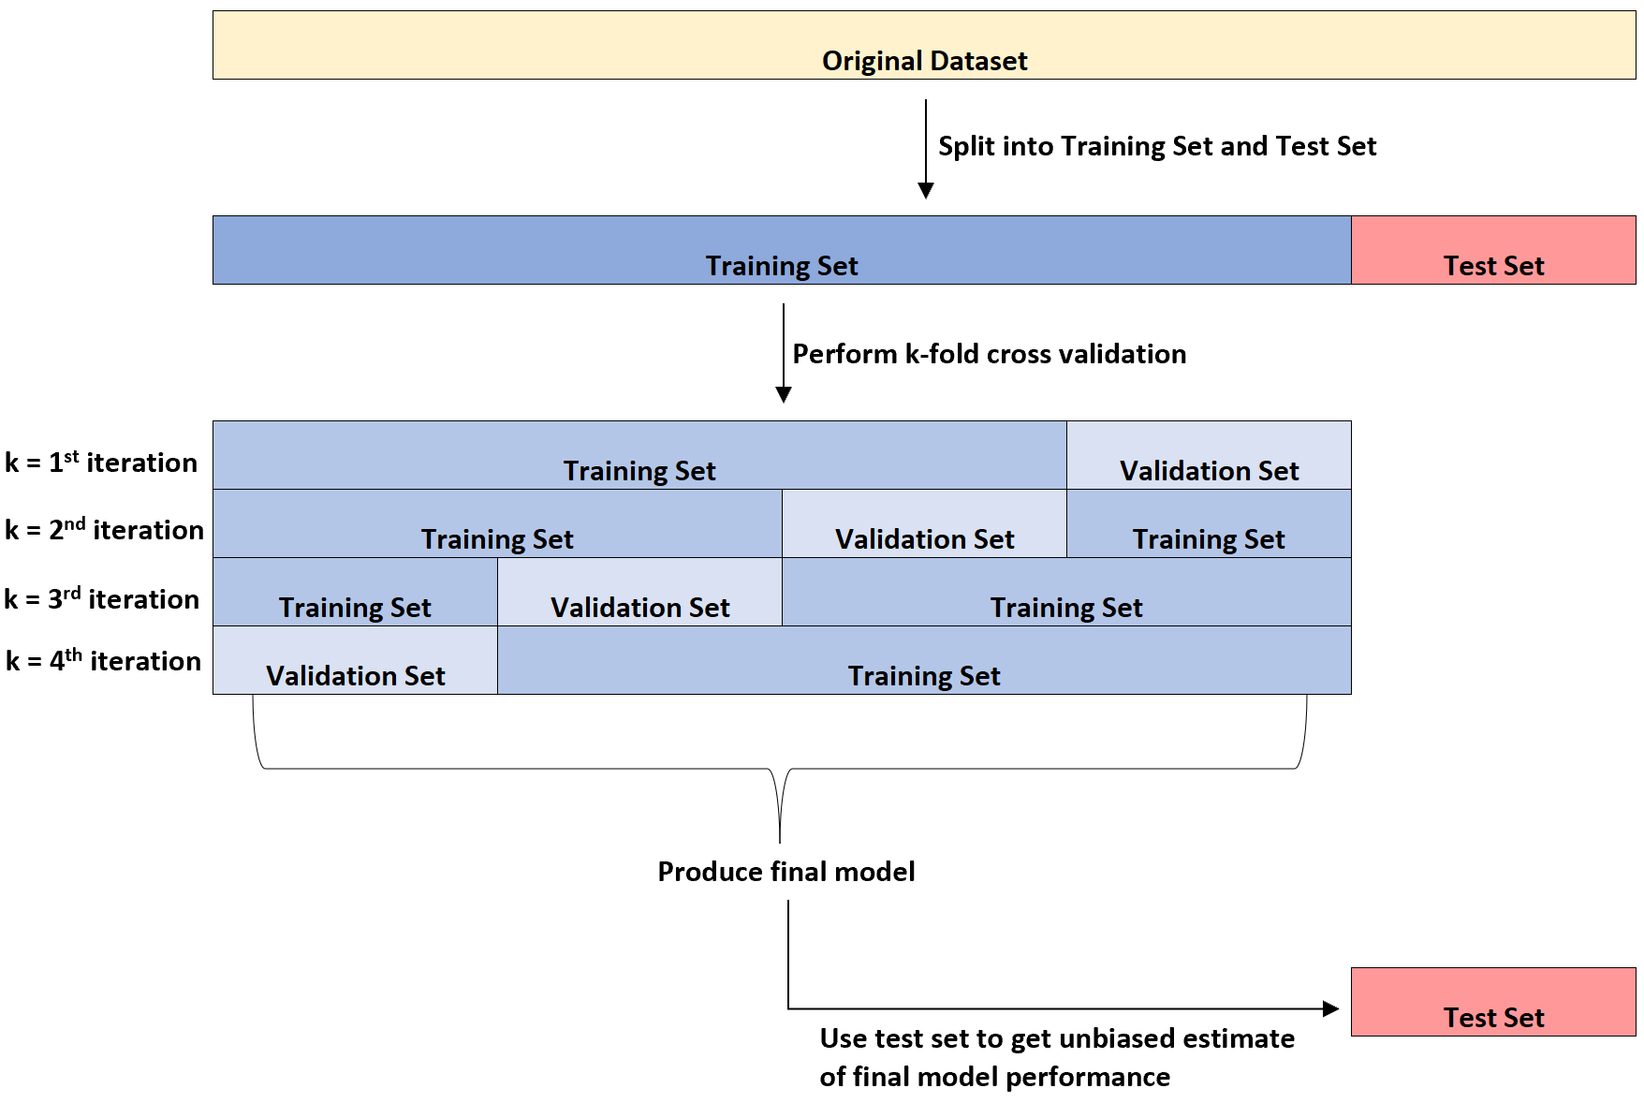
K – fold cross validation

Slide 3
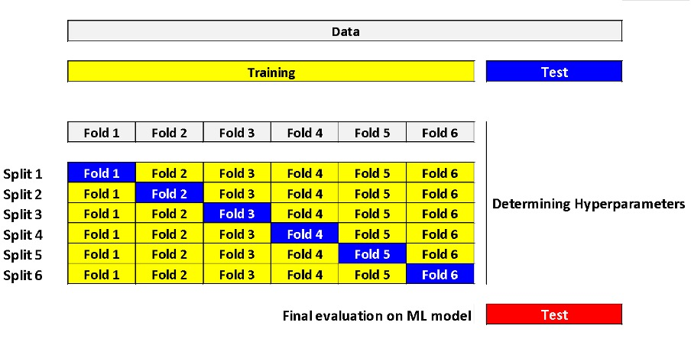
K – fold cross validation

